Slide 1
JAVA 8, 9, 10 Main Features
The more we help, the more we succeed.
Samveg Lunawat
December 18th , 2019

Slide 2
Agenda
Java 8 features
Java 9 features
Java 10 features
Q&A

Slide 3
Java 8 Features
Default methods in the interface.
Static methods in interface
Multiple Inheritance
Functional Interface
Lambda Expressions
Internal iteration vs external iteration - ForEach
Method Reference
Optional Class
StringJoiner – Uses StringBuilder internally
Used to join the String.
Notes:
Where we can use in Postilion?

Slide 4
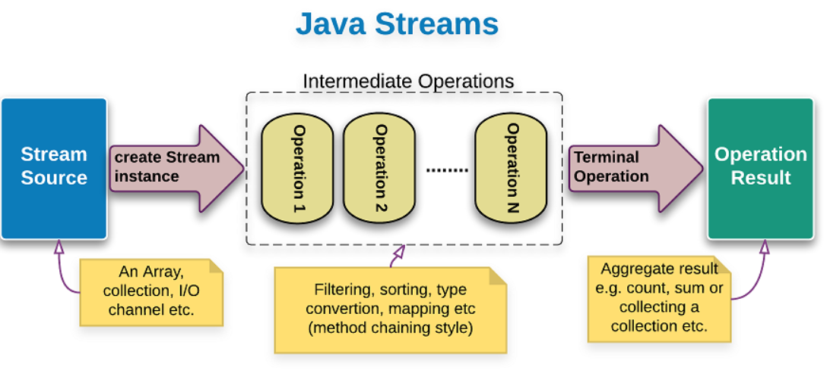
Java 8 Features – Continue..
Consumer, Predicate

Slide 5
Java 9 features
Factory methods for Immutable list, set, map
In Java SE 8 and earlier versions, We can use Collections class utility methods like unmodifiableXXX to create Immutable collections objects.
E.g Collections.unmodifiableList. However, methods are a tedious and verbose approach.
Java 9 provides methods like .Of(), which provides the immutable objects.
Private methods in interface.
Constant variables
Abstract methods
Default methods
Static methods
Private methods
Private Static methods

Slide 6
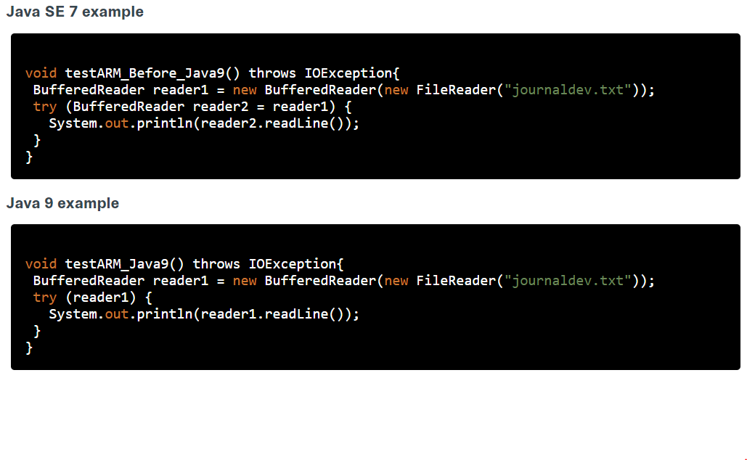
Java 9 Features – Continue..
Try with Resource Improvements

Slide 7
Java 10 features
Keyword “var” (Local-Variable Type Inference)
var company = "Codete"; // infers String
var characters = company.toCharArray();
var numbers = List.of("a", "b", "c");
for (var nr : numbers)
{
System.out.print(nr + " ");
}
var foo;
var ints = {0, 1, 2};
var appendSpace = a -> a + " ";
private var getFoo() { return "foo"; }
Notes:
Can’t be used as class variable.
Not permitted for uninitialized variables.
Not allowed as parameter for method.
Not as return type of method
Not permitted with variable initialize with null.

Slide 8
Java 10 Features – Continues..
Parallel Full GC for G1
G1 is the default GC starting from Java 9. It was mainly designed to avoid full collections and preventing the “stop the world” event. It increased the performance significantly, however, there was still probability that if concurrent collections couldn’t reclaim memory quickly enough, then classic full GC would be used as a fallback.
Therefore in Java 10 they took care of this particular situation too and improved the algorithm to parallelize the full GC.

Slide 9
Q&A

